Slide 1
Iterative Methods
PHYS3112 – Tutorial 5

Slide 2
Today we will:
Beginner Level
Learn about iterative structures (for loop, while loop)
Perform a basic iterative computation (single variable)
Intermediate level
Learn the finite-difference approximation
Numerically integrate an ODE (without using ODE int!)
Advanced Level
Learn the tri-diagonal matrix formulation for DEs
Solve 1D Poisson’s equation using matrices and inbuilt routines

Slide 3
Iterative Methods - Motivation
Iterative methods are what computers are REALLY GOOD AT:
Some simple calculation that needs to be repeated with small differences in input.
ODE int (from tutorial 3) is actually an iterative method! It’s just hidden inside the ODEint function so you don’t get that experience.
It’s useful for simulations of time-evolving systems, or spatially varying systems.
The principal complication is the how each iteration depends on the value of the iteration before it.

Slide 4

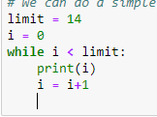
The For and While Loops
These loops allow us to repeat a computation a set number of times.
For loops allow us to do things a certain number of times
While loops allow will keep going while something is true

Slide 5
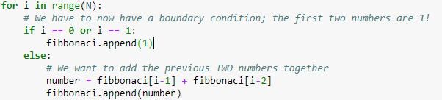
Iterating through time; continuous updates
Instead of simply repeating a calculation, we can iterate through time/space to make evolving calculations. Usually this involves each calculation using the data from a previous calculation.
Eg, fibbonaci sequence;
The most common way to do this is for time-evolving systems, where the current state depends slightly on the previous state.

Slide 6
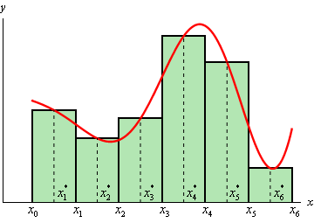

Intermediate starts here
We’re going to numerically integrate the following differential equation:
We’re NOT going to use ODE-int this time, because we are using this to develop our simulation skills (and we will soon hit problems for which ODEint is useless).
$$\frac{dx}{dt}=\frac{sin⁡(t)}{t}$$
To do this we will be stepping through time and evaluating x(t) as we go.
This is a similar idea to what you may have learnt when first solving integrals.

Slide 7
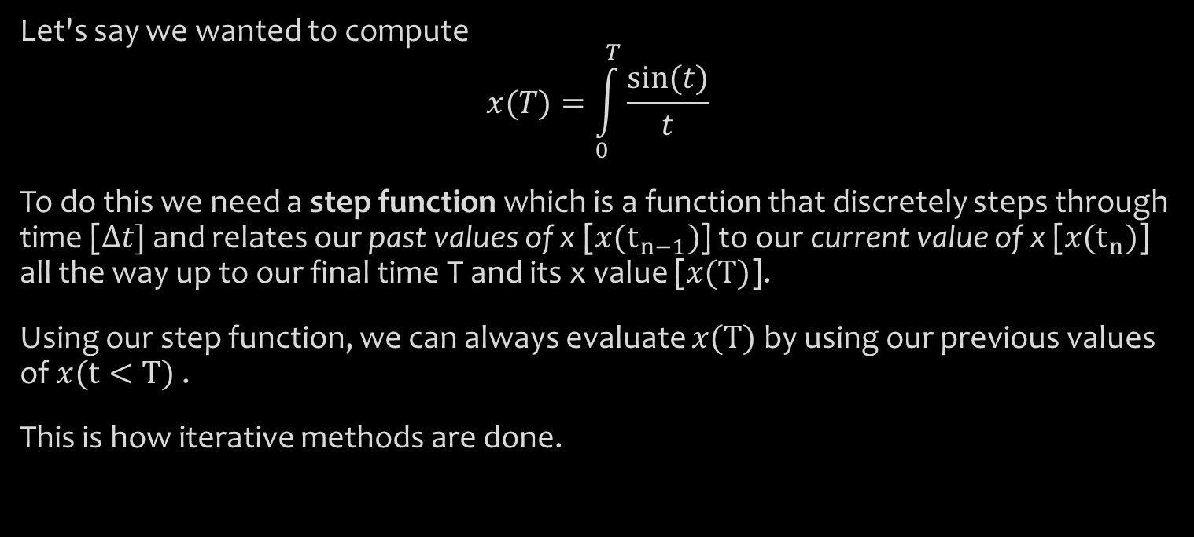
Stepping functions
Let's say we wanted to compute
$$x(T)=\int_{0}^{T}{\frac{sin⁡(t)}{t}}$$
To do this we need a step function which is a function that discretely steps through time [$Δt]$ and relates our past values of x [$x(t_{n−1})$] to our current value of x [$x(t_{n})$] all the way up to our final time T and its x value [$x(T)$].
Using our step function, we can always evaluate $x(T)$by using our previous values of $x(t<T)$.
This is how iterative methods are done.

Slide 8




Determining the step function
$$\frac{dx}{dt}=\frac{sin⁡(t)}{t}$$
For our first step function lets use the finite-difference approximation of the derivative:
Which we can then extend:
And we get our step-function!
$${\left(\frac{dx}{dt}\right)}_{n}=\frac{x\left(t_{n}\right)−x\left(t_{n−1}\right)}{Δt}$$
$${\left(\frac{dx}{dt}\right)}_{n}=\frac{x\left(t_{n}\right)−x\left(t_{n−1}\right)}{Δt}=\frac{\sin\left(t_{n}\right)}{t_{n}}$$
$$x\left(t_{n}\right)=x\left(t_{n−1}\right)+Δt×\frac{\sin\left(t_{n}\right)}{t_{n}}$$

Slide 9
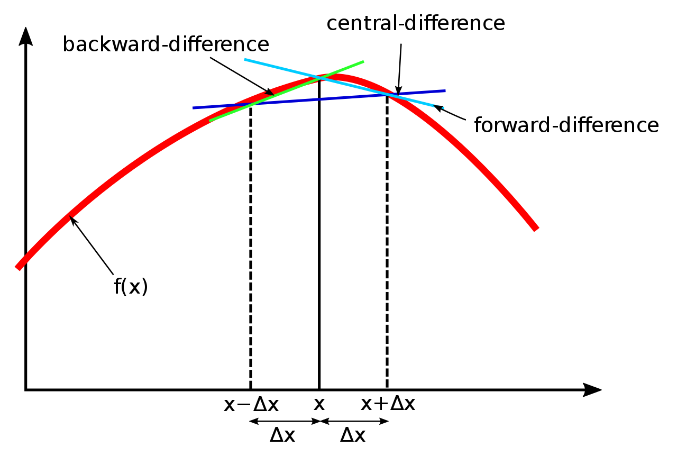
Notes on step function
Obviously this is more accurate at small timesteps (delta t)!
There are better numerical approximations of derivatives out there, I have used the simplest one (backward difference or backward Euler method).

Slide 10
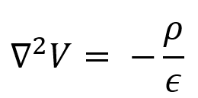
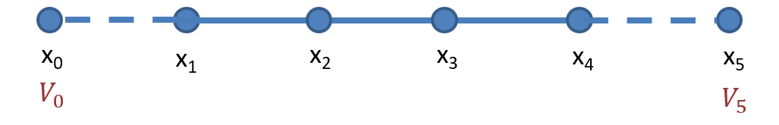
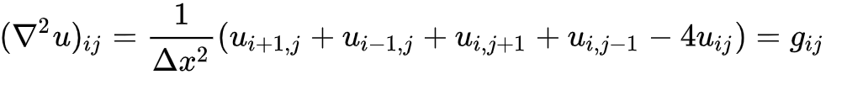

Advanced – 1D Poisson Equation
Sometimes, a DE can’t be solved by simply iterating one thing after another.
An example of this is the Poisson equation:
It can be thought of as a string of electrically charged particles where $ρ$ is the charge distribution and $V$ are the voltages.
Which has a 2-D stepping function:
(See lecture notes for how this sort of stepping function is derived)

Slide 11
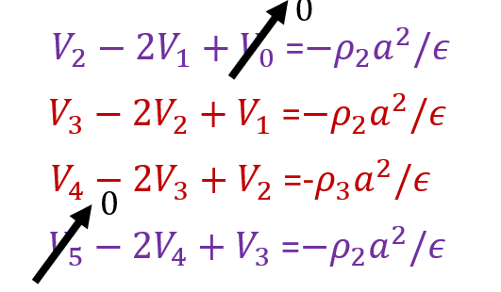
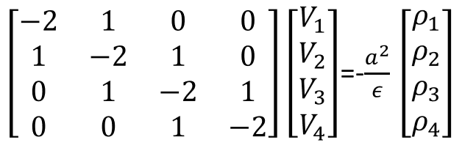
The Tridiagonal Matrix
If you arrange the stepping function into a series of equations, you’ll yield a matrix:
(Again, refer to lectures; these are just screenshots!)
1
4

Slide 12
How do we solve it?
There’s a rather nice algorithm called the ‘Thomas Algorithm’ that is computationally efficient. Specifically works for tridiagonal matrices.
However, we can simply do matrix inversion in python. (note; this is very inefficient for large data sets!)

Slide 13
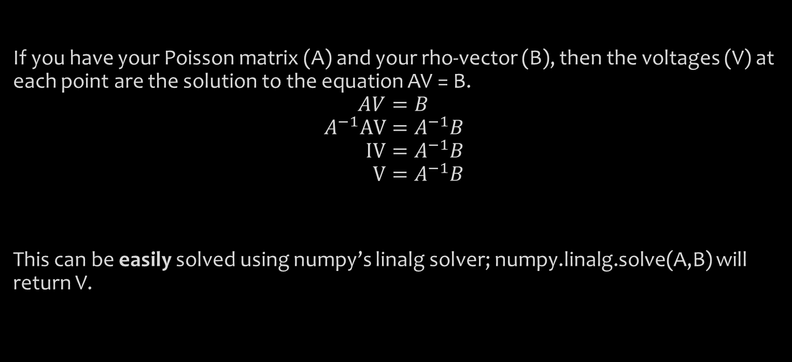
Example – Matrix Inversion
If you have your Poisson matrix (A) and your rho-vector (B), then the voltages (V) at each point are the solution to the equation AV = B.
$$AV=B \\ A^{−1}AV=A^{−1}B \\ IV=A^{−1}B \\ V=A^{−1}B$$
This can be easily solved using numpy’s linalg solver; numpy.linalg.solve(A,B) will return V.

Slide 14
Boundary conditions – Edge Voltage (Dirichlet Boundary condition)
A key thing to be able to do is to modify your poisson matrix to account for boundary conditions.
For example, what if the edge values of voltage are constrained to be a certain value?
This introduces two extra terms: V0 and V5 into our (four by four) matrix. Do we now have a 6x6 matrix?

Slide 15
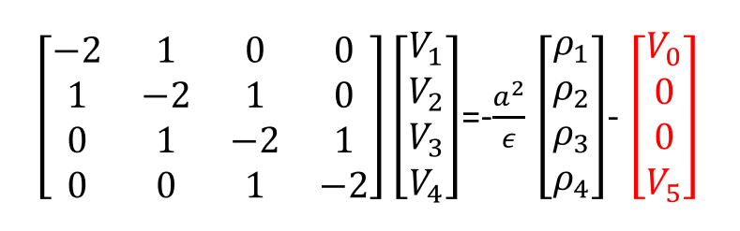
No! Because V0 and V5 only show up once apiece, we can modify their sections of the matrix only:
So we can complete these boundary conditions by modifying the rho vector. (again, derivation shown in lecture)

Slide 16
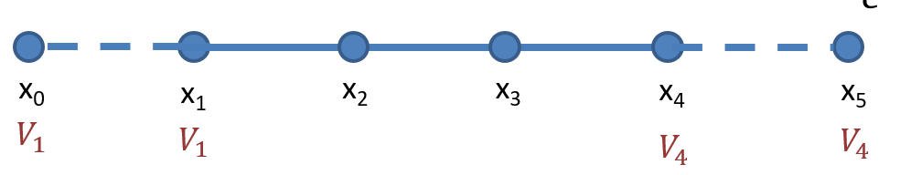
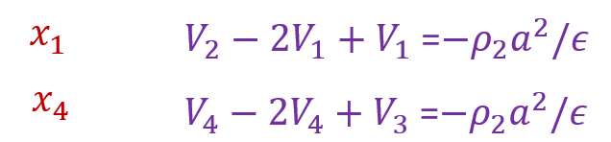
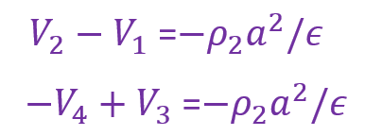
Boundary Condition: Constant Gradient (Neumann Boundary condition)
We can also specify the gradient at the boundaries of our simulation. This is equivalent to fixing the relationship between the edge values and the off-edge values.
This changes our equations!
becomes

Slide 17
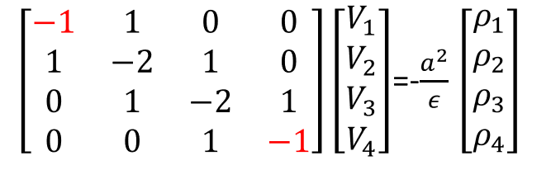
Finally, we get a matrix simplification

Slide 18
Your tasks
Make your way through the advanced tutorial notebook, and ensure you understand the process of matrix solving.
Go through lecture notes and try to understand how the Poisson matrix is derived (and ask me for help!)
Experiment with a variety of boundary conditions; for example, what if the gradient was set such that V1 = 2V0? How would that change the Poisson matrix?

Slide 19
Further steps
So far this is still only 1D
We have fixed our Step size (a) to be constant for all positions in our mesh
It is time constant
Other questions / comments? Please let me know! There is a lot of ground that can be covered and I’m unsure as to what you would like.

